Slide 1
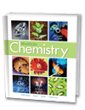
Chapter 20
Oxidation-Reduction
Reactions
20.1 The Meaning of Oxidation
and Reduction
20.2 Oxidation Numbers
20.3 Describing Redox
Equations

Slide 2
Identifying Redox Reactions
Identifying Redox Reactions
What are the two classes of chemical reactions?

Slide 3
Identifying Redox Reactions
All chemical reactions can be assigned to one of two classes.
One class of chemical reactions is oxidation-reduction (redox) reactions, in which electrons are transferred from one reacting species to another.
The other class includes all other reactions, in which no electron transfer occurs.

Slide 4
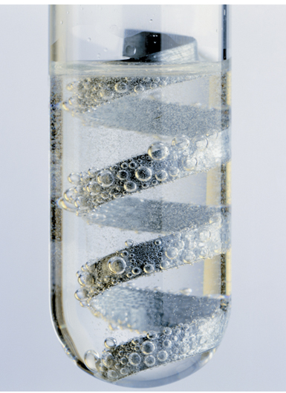
Identifying Redox Reactions
Many single-replacement reactions, combination reactions, decomposition reactions, and combustion reactions are redox reactions.
Zinc metal reacts vigorously with hydrochloric acid to produce hydrogen gas and zinc chloride.

Slide 5
Identifying Redox Reactions
Examples of reactions that are not redox reactions include double-replacement reactions and acid-base reactions.

Slide 6
Sample Problem 20.5
Identifying Redox Reactions
Use the change in oxidation number to identify whether each reaction is a redox reaction or a reaction of some other type. If a reaction is a redox reaction, identify the element reduced, the element oxidized, the reducing agent, and the oxidizing agent.
a. Cl₂(g) + 2NaBr(aq) → 2NaCl(aq) + Br₂(aq)
b. 2NaOH(aq) + H₂SO₄(aq) → Na₂SO₄(aq) + 2H₂O(l)

Slide 7
Sample Problem 20.5
1
Analyze Identify the relevant concepts.
If changes in oxidation number occur, the reaction is a redox reaction.
The element whose oxidation number increases is oxidized and is the reducing agent.
The element whose oxidation number decreases is reduced and is the oxidizing agent.

Slide 8
Sample Problem 20.5
2
Solve Apply concepts to this situation.
a. Assign oxidation numbers.
0 +1 –1 +1 –1 0
Cl₂(g) + 2NaBr(aq) → 2NaCl(aq) + Br₂(aq)

Slide 9
Which of the following are redox reactions?
A. NH₃ + HCl → NH₄Cl
B. SO₃ + H₂O → H₂SO₄
C. NaOH + HCl → NaCl + H₂O
D. H₂S + NHO₃ → H₂SO₄ + NO₂ + H₂O

Slide 10
Which of the following are redox reactions?
A. NH₃ + HCl → NH₄Cl
B. SO₃ + H₂O → H₂SO₄
C. NaOH + HCl → NaCl + H₂O
D. H₂S + NHO₃ → H₂SO₄ + NO₂ + H₂O

Slide 11
Sample Problem 20.5
2
Solve Apply concepts to this situation.
a. Interpret the change (or lack of change) in oxidation numbers to identify if the reaction is a redox reaction.
0 +1 –1 +1 –1 0
Cl₂(g) + 2NaBr(aq) → 2NaCl(aq) + Br₂(aq)
This is a redox reaction.
The chlorine is reduced.
The bromide ion is oxidized.
Chlorine is the oxidizing agent; the bromide ion is the reducing agent.

